Slide 1
Mininet-WiFi exercise (Part 2)
Course 34351 Access- and Home Networks

Slide 2
Mininet-WiFi exercise
The Mininet-WiFi exercise is one of the mandatory exercises in course 34351
Takes place over four consecutive weeks:
Date | Topic
2024-02-08 | Introduction to Mininet-WiFi, Getting the software installed and tested ✓
2024-02-15 | Exercise part 1
2024-02-22 | Exercise part 2 (today)
2024-02-29 | Wrap-up if there are parts you’re missing – otherwise work on your journal
2024-03-06 | Deadline for handing-in the journal to the assignment on DTU Learn @23.59

Slide 3
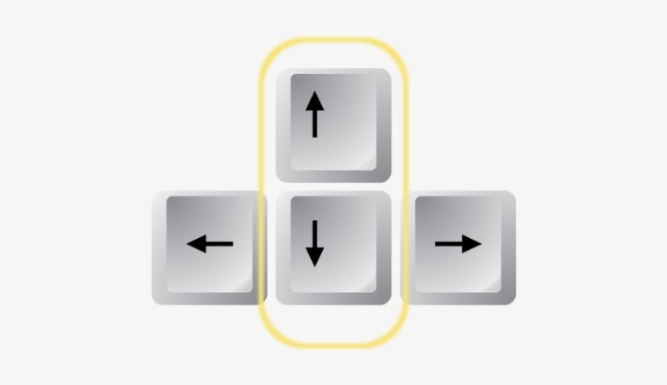
General tips
Disable Linux’s built-in network-manager (should be done every time the VM is started):
Linux CLI: sudo systemctl stop NetworkManager.service
Saving Mininet-WiFi output (but unfortunately not your input):
Linux CLI: sudo python myscript.py 2>&1 | tee outputfile.txt
Resetting Mininet-WiFi (good practice if the emulator is not terminated correctly):
Linux CLI: sudo mn -c
Use the up and down arrow keys on your keyboard to quickly scroll up and down in your command history. (Both the Linux CLI and the Mininet-WiFi CLI)

Slide 4
Testing throughput with iperf
Start the iperf server in an xterm window, e.g.,
In the Mininet-CLI: xterm <serverdevice>
Change the font size by Ctrl + Rightclick in the xterm window
In the xterm window that opens: iperf -s
Start the iperf client in the Mininet-CLI, e.g.,
In the Mininet-CLI: <clientdevice> iperf -c <serverdevice>

Slide 5
Mobility for a wireless station (here: sta1)
Defining a trajectory for a station (insert before net.build() ): net.startMobility(time = 0) net.mobility(sta1, 'start', time = 20, position = 'x₀,y₀,z₀') net.mobility(sta1, 'stop', time = 40, position = 'x₁,y₁,z₁') net.stopMobility(time = 41)

Slide 6
Assignment
Start working on the two tasks in part 2 of the exercise manual
Add documentation to the lab journal from last time
Hand-in the complete lab journal on Learn
Deadline: March 6
If you’re not finished today, there will be (some) time next week

